Slide 1

EMPLOYEE MANAGEMENT SYSTEM
BIRMINGHAM CITY UNIVERSITY
FACULTY OF COMPUTING ENGINEERING
AND THE BUILT ENVIRONMENT
CMP7174 Service Oriented Architecture

Slide 2
Team Members & their work contribution
Manpreet Kaur(20176130): I worked on app design and make ppt for presentation, create employee management registration service
Harjinder Kaur (21101399) ; She worked on (WDS) working days service - REST ( service for working days and shifts of all employees)
Ramandeep Singh (20163495):
He worked on (DS)department service - REST ( Manage all departments) also help Shrey in BPEL services integration
Shrey Mukundkumar Pandya (20143506): He worked on connect BPEL services (BMS)bpel main service - SOAP ( Put all services together)
Md Alauddin Mazumdar (21103687) :
He helped me references to make doc file for design and also worked on (SS)salary service (Generating and showing salary reports)

Slide 3
Introduction
The company which hired us already uses Employee Management System (EMS). They have some desktop application which store all employees into local database. They use current application to store data about Employees shifts, working / non-working days, salary, departments etc.
This application has many issues. One of main issues is that it does not support access from net. They have partially resolved this issue by enabling access over LAN network inside company. But still, data are stored in one place (local hard drive).
Company has decided to invest in software and design modern and service oriented application. This way, they will get web application accessible from any place in the world connected to internet. Moreover, they will get application which can be easily extended in future for new features (such as commercial calculations and personal data).

Slide 4
Business Requirements
EMS should enable Employee to Register account (different roles enabled)
EMS should enable Employee to Login
EMS should enable Employee to Edit Employee details
EMS should enable Employee to Delete Employee details
EMS should enable Employee to Enter working days
EMS should enable Employee to Update working days
EMS should enable Employee to Store Shift details
EMS should enable Employee to Add Department
EMS should enable Employee to Edit Department
EMS should enable Employee to Delete Department
EMS should enable Employee to View Salary Report

Slide 5
Proposed Solution
Service-Oriented Architecture or SOA is an architectural approach for designing and developing a web application. In this approach, an application uses services available over the network via communication calls or requests.
SOA architecture has next advantages:
Reliability
Location Independence
Scalability
Platform Independence
Loosely Coupled
Reusability
Agility
Easy Maintenance

Slide 6
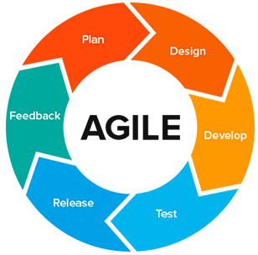
Software Development Model
The literal meaning of Agile is “Able to move quickly and easily", in terms of software development Agile would imply “flexible” process to respond to changes quickly and the same is true, allowing a developer to go back to a previous stage and carry out necessary changes there by refining the software without much delay as compared to the convention plan driven Software development methods.
Development life cycle phases as shown on image. We start from Plan and end with Feedback.

Slide 7
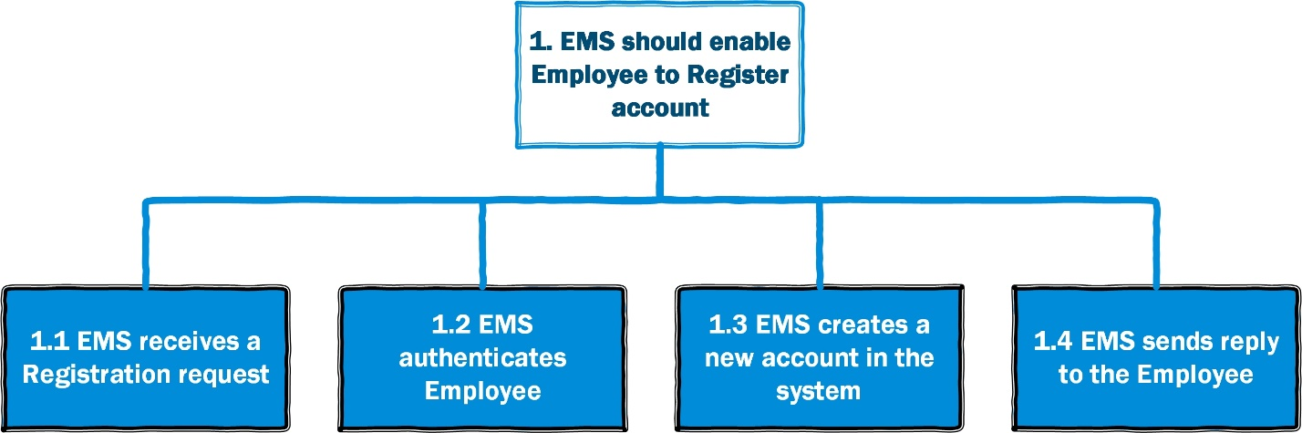
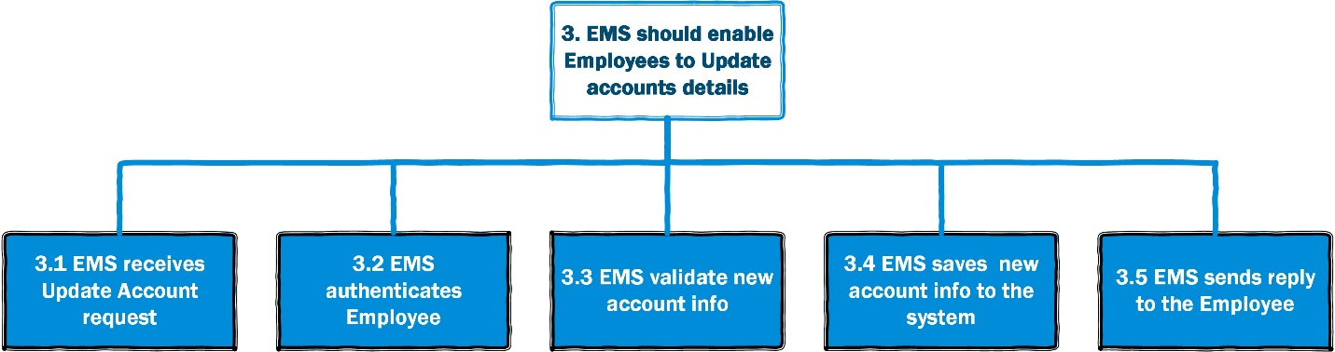
Service Identification
Some of Processes shown on Diagram

Slide 8
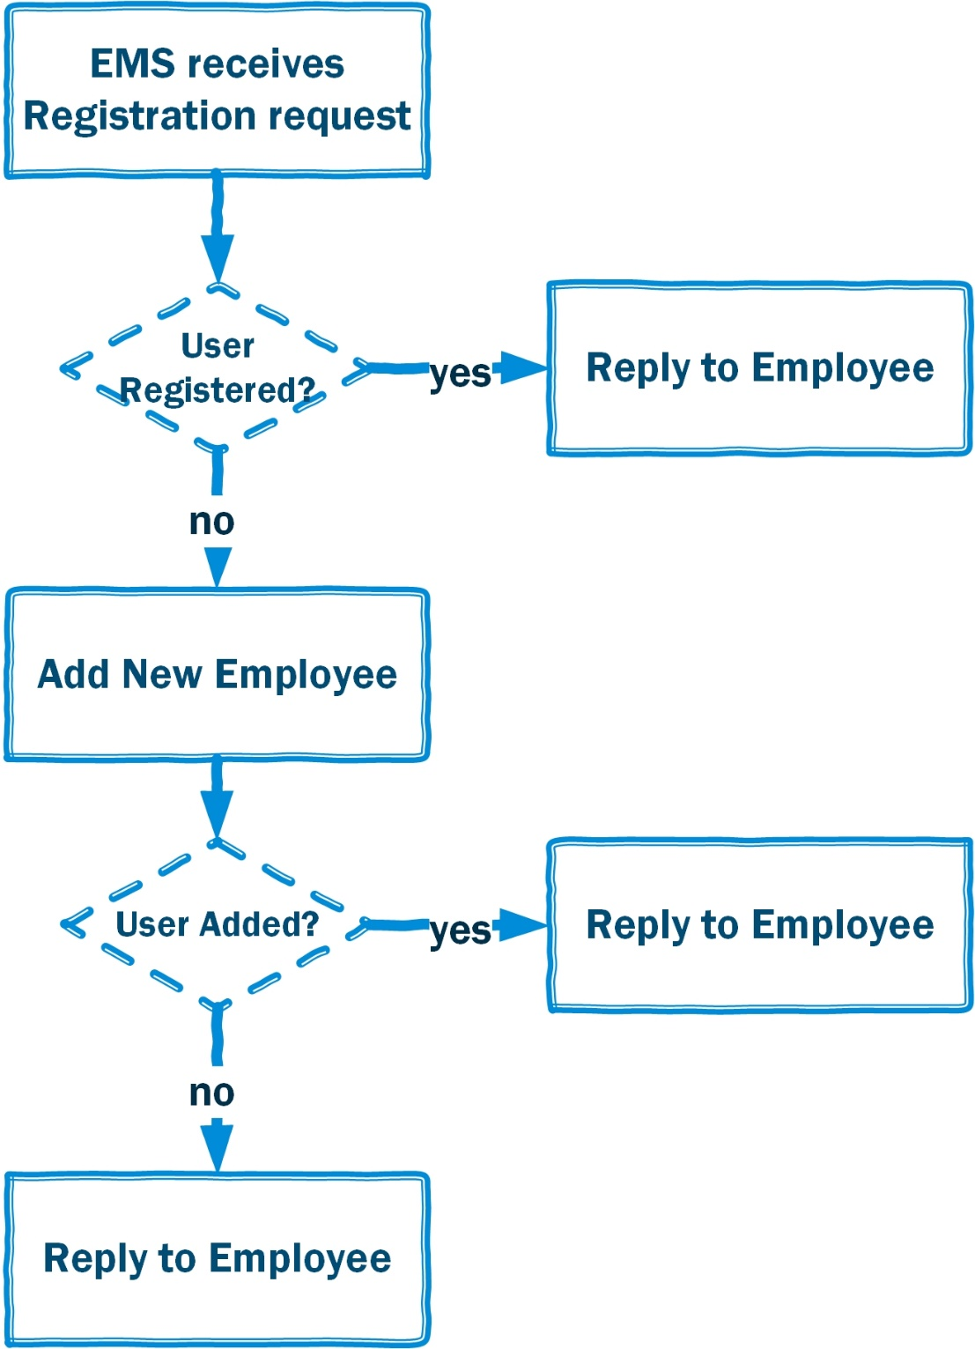
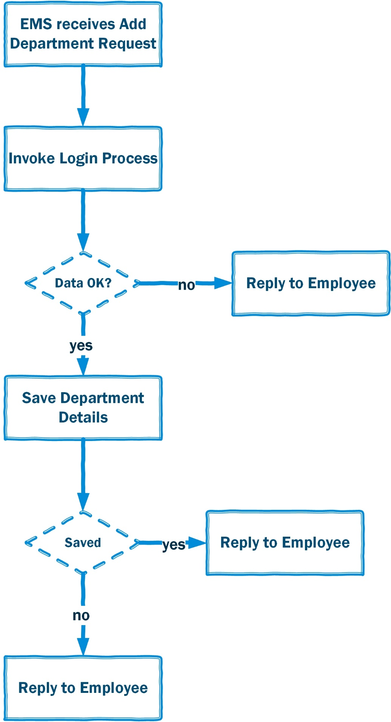
System processes

Slide 9
Identified Services
Name | Short Name | Description | Type
Employee Registration Service | ERS | Registration and Login of Employees | SOAP
Working Days Service | WDS | Service for Working Days and Shifts of all Employees | REST
Department Service | DS | Manage all Departments | REST
Salary Service | SS | Generating and showing salary reports | REST
BPEL Main Service | BMS | Put all services together | SOAP

Slide 10
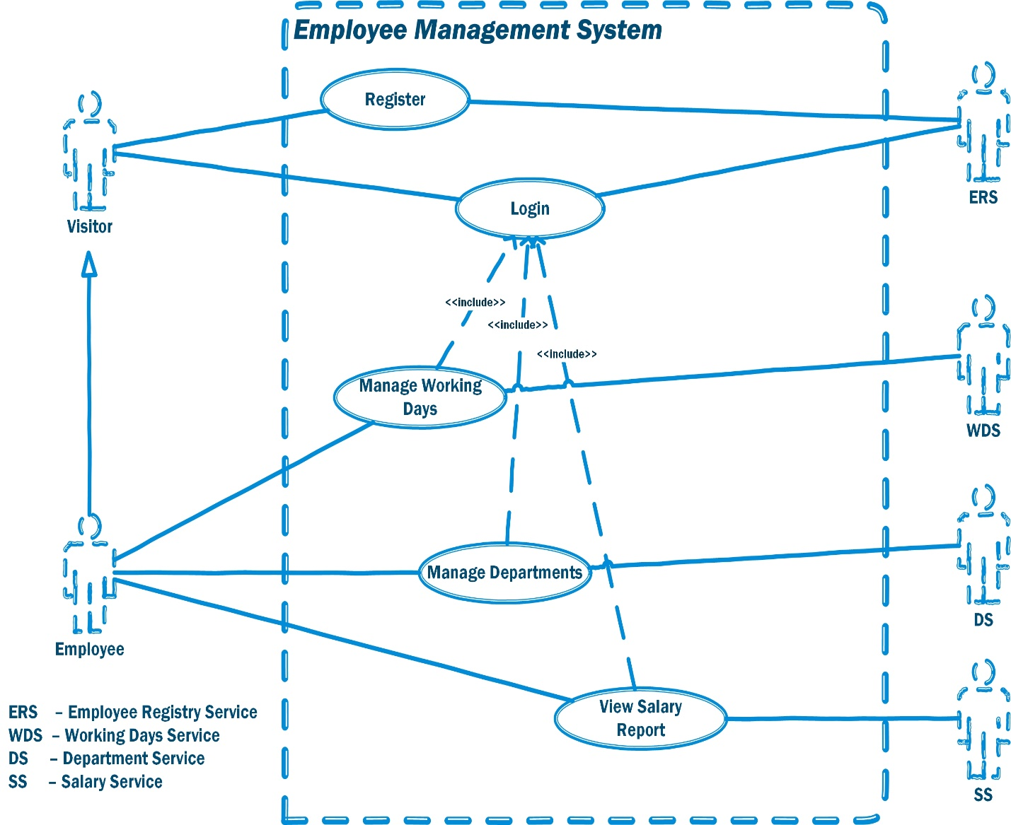
Use Case Diagram

Slide 11
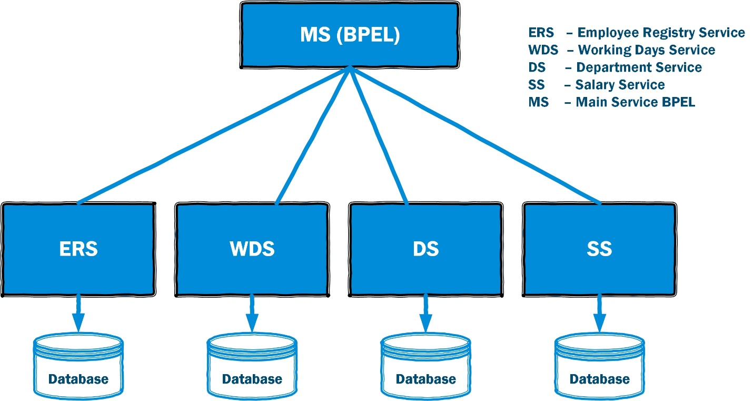
Service Architecture Diagram

Slide 12
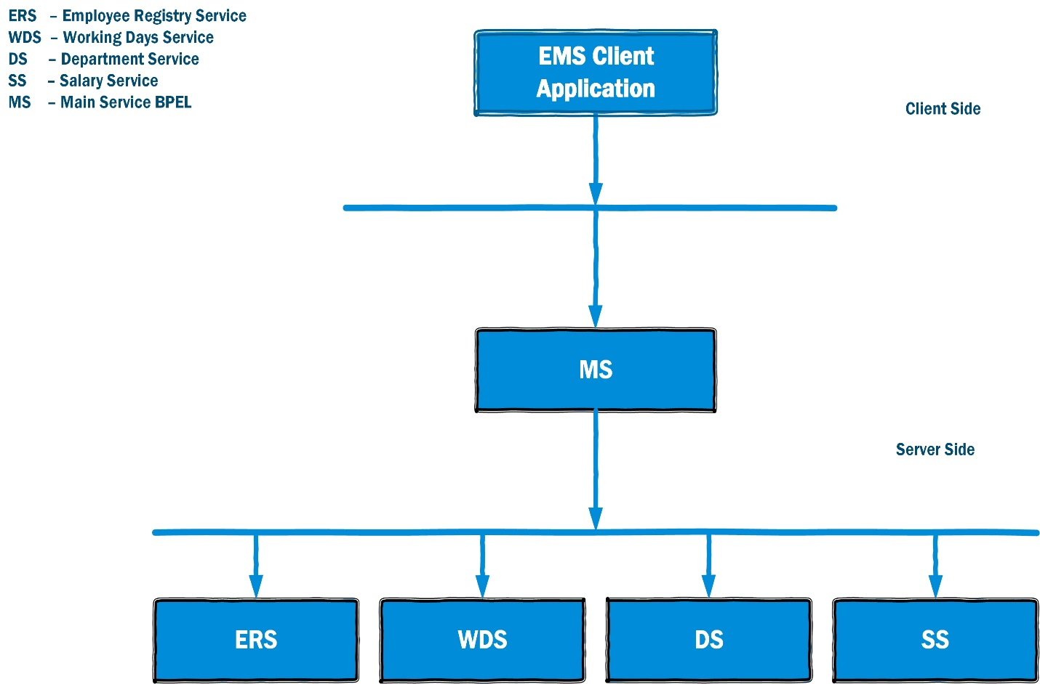
Service Communication Diagram

Slide 13
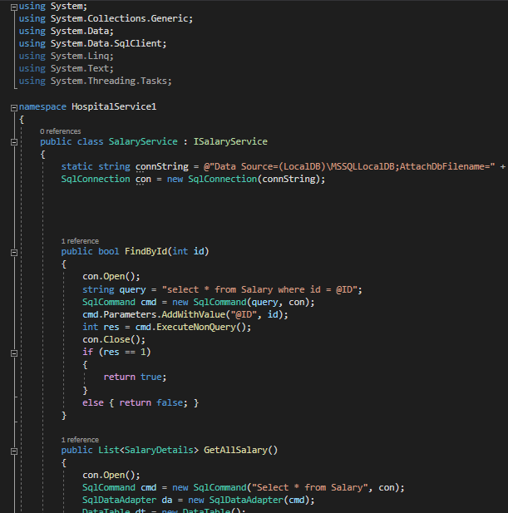
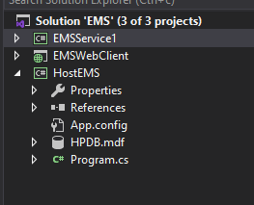
Visual Studio & .NET Technology
Project Structure
Code Snippet – Salary Service

Slide 14
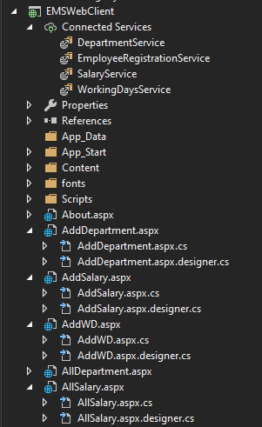
Employee Registration service
EMSWebClient Structure with Connected Services
1 SOAP – EmployeeRegistrationService
3 REST (Salary, Department and WorkingDays)

Slide 15
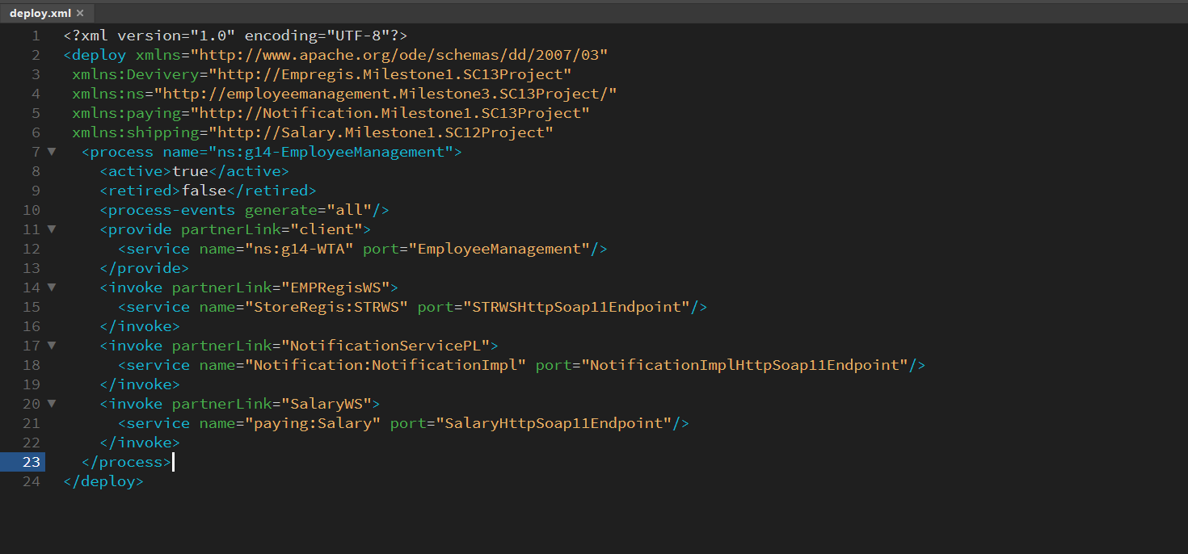
Oracle SOA BPEL Technology
Using the WebLogic Server Administration Console to Deploy and Undeploy an Application.
You can use the Oracle WebLogic Server Administration Console to deploy and undeploy an application to an Oracle SOA Service instance, just as you would deploy and undeploy the application to an on-premises service instance.

Slide 16
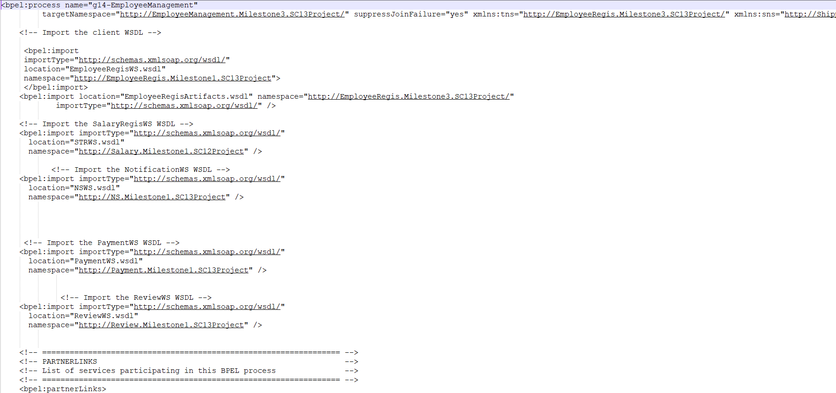
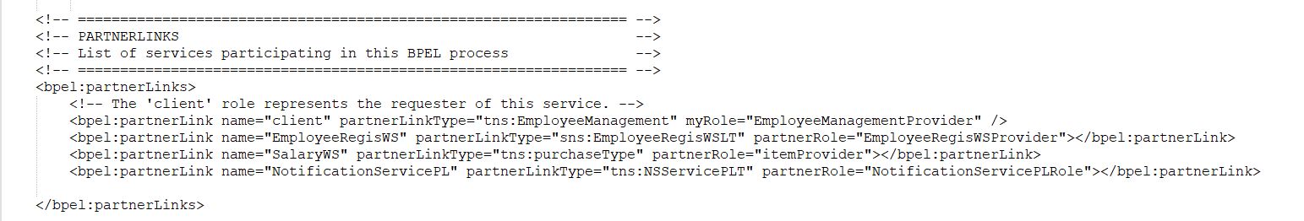
BPEL

Slide 17
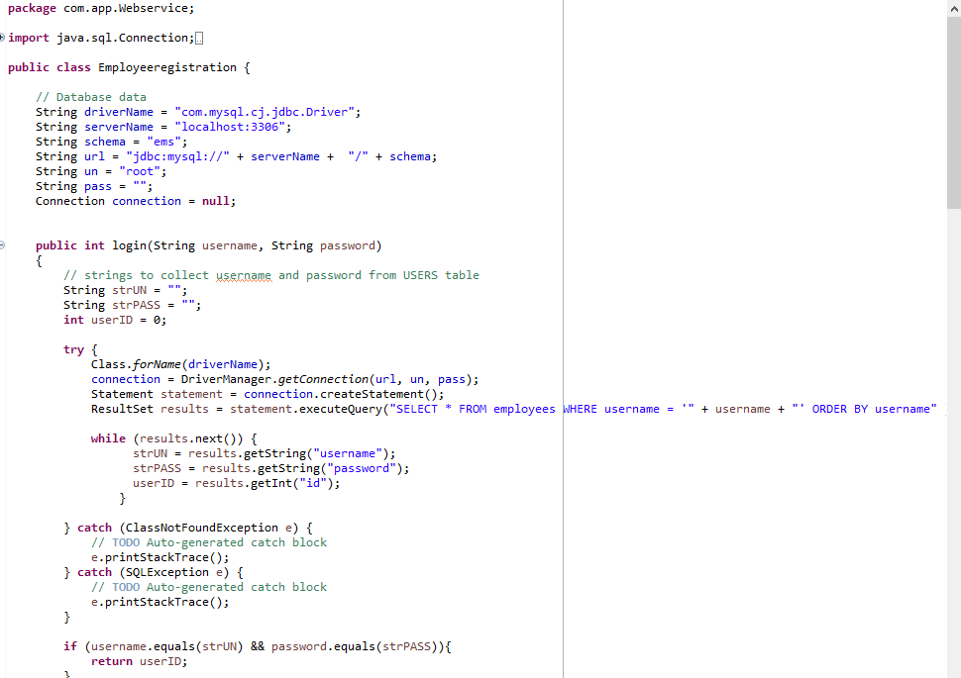
Implementation – Java SOAP Technology

Slide 18
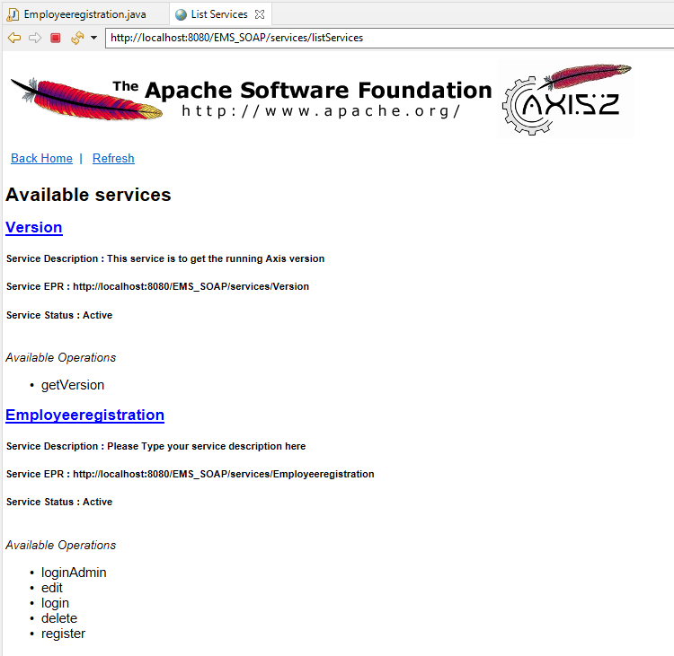
Apache Software
Apache Tomcat Server running with EMS EmployeeRegistration service.
Axis2 used
Available Operations shown on bottom of image

Slide 19
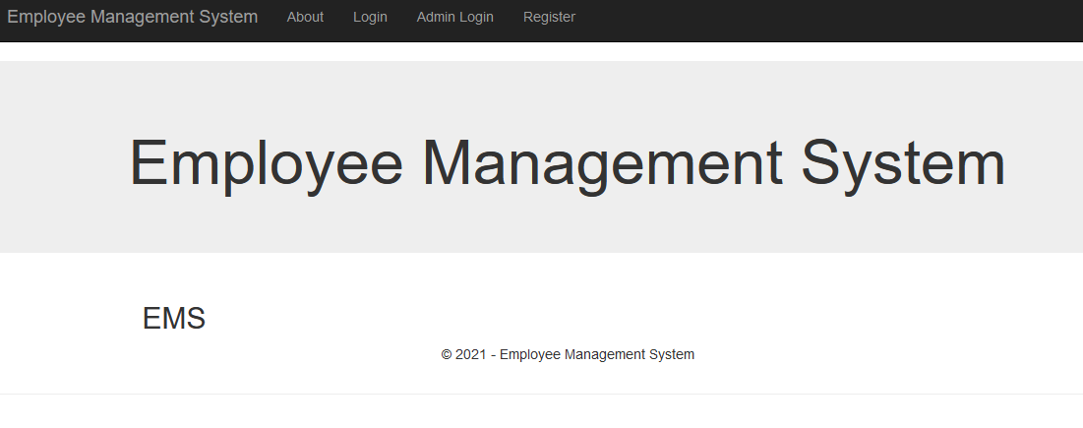
Client Application
Default page (About, Login, Admin Login and register options)

Slide 20
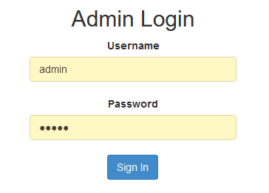
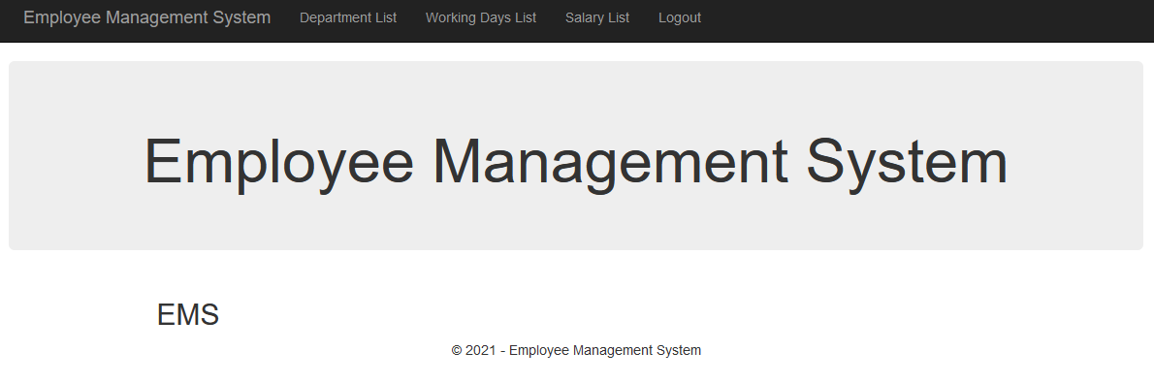
Admin login page
After logged as Admin options are:
Department List
Working Days List
Salary List
Logout

Slide 21
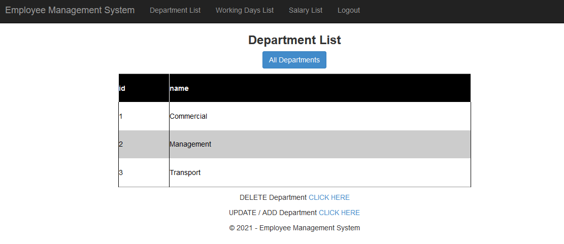
Department List
All Departments with option to Delete and Update/Add Department

Slide 22
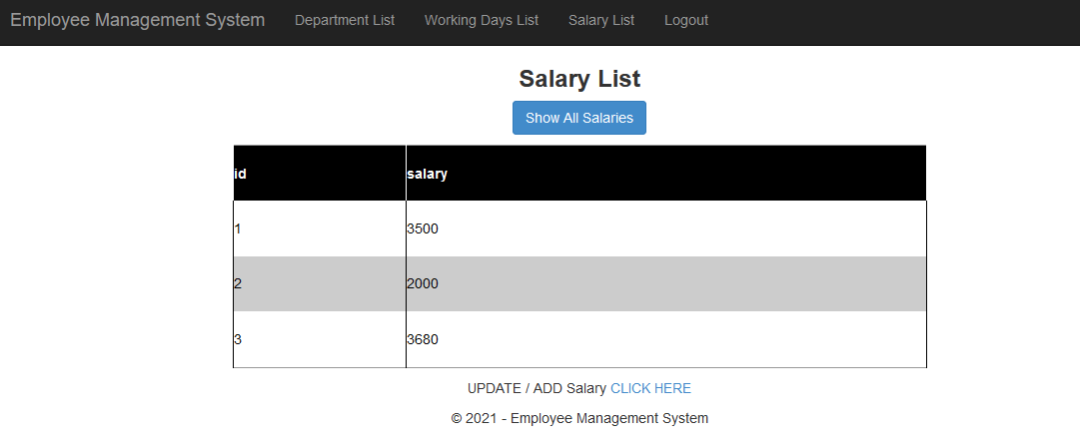
Salary List
Salary List with option to Update/Add Salary

Slide 23
Discussion
Employee Management System EMS is built using Service Oriented Architecture (SOA). This approach offers many important advantages and some dis-advantages. Here, we will shortly just number them. It is decision on owners to decide is it worth of investing or not.
Advantages: Service Reusability. Easy Maintainability, Greater Reliability, Location Independence, Improved Scalability and Availability, Improved Software Quality, Platform Independence etc.
Disadvantages: Increased Overhead, Complex Service Management, High Investment Cost.

Slide 24
Conclusion
Employee Management System is built by using of SOA approach. This approach offers better quality of entire application, but it is harder in the very beginning to establish entire system using services. This will probably cost more than developing system without services.
On other hand, EMS will have ability of easy extensibility.
If company relies on quality and good design, we can recommend SOA approach as greatest choice.

Slide 25
References
Agile in SDLC (2019) Educba.com. Available at: https://www.educba.com/agile-in-sdlc/ (Accessed: August 31, 2021).
Agile Methodology and System Analysis (no date) Umsl.edu. Available at: http://www.umsl.edu/~sauterv/analysis/Agile%20Methodology%20and%20System%20Analysis.htm (Accessed: August 31, 2021)
Gambetta, D. (2020) Free Agile software on the web - Accurate Reviews, Accuratereviews.com. Available at: https://www.accuratereviews.com/free-agile-software/ (Accessed: August 31, 2021).
Key benefits of service Oriented Architecture (no date) Decipherzone.com. Available at: https://www.decipherzone.com/blog-detail/service-oriented-architecture (Accessed: August 31, 2021).
Nasir, H., Suleman, H., Lakshmikanth, R. and Farahani, M., 2021. What is Agile model – advantages, disadvantages and when to use it?. [online] Tryqa.com. Available at: <http://tryqa.com/what-is-agile-model-advantages-disadvantages-and-when-to-use-it/> [Accessed 19 August 2021].
Oracle.com. 2021. Service-Oriented Architecture (SOA) and Web Services: The Road to Enterprise Application Integration (EAI). [online] Available at: <https://www.oracle.com/technical-resources/articles/javase/soa.html> [Accessed 19 August 2021].
Tech Spirited. 2021. Advantages and Disadvantages of Service-oriented Architecture (SOA). [online] Available at: <https://techspirited.com/advantages-disadvantages-of-service-oriented-architecture-soa> [Accessed 19 August 2021].
www.javatpoint.com. 2021. Agile Model (Software Engineering) - javatpoint. [online] Available at: <https://www.javatpoint.com/software-engineering-agile-model> [Accessed 19 August 2021].

Slide 26

Questions?

